Slide 1
Nextest UI Tracker V2.1
Yet Ebreo - R&D TE
18 July 2016

Slide 2
What’s New
Fixed the bug where the environment variables set by previous user is retained on next session/user
Improved the change UI feature of the tool
Minor UI changes

Slide 3

Update Instructions
Below are the steps how to update from version 2.0 to 2.1:
Make sure no UI is running, better to close all running apps
Press Win + R then type ‘cmd’. Windows command prompt will appear
Type taskkill /f /im systemservice* /im nxtuitrack* this will completely terminate the currently running Nextest UI Tracker
Run the nxtuitrack-setup.exe, then follow the instructions during the installation process

Slide 4
Caldata Update
The change UI feature now copies the caldata from a dedicated folder to C:\nextest\caldata.
UI Specific caldata
caldata for specific UI’s must be placed at
C:\nextest\caldata_<UI version with out “.”>.
For example, caldata for UI version h3.8.4C2_Beta must be placed at c:\nextest\caldata_h384C2_Beta
Caldata for UI version h3.7.12 must be placed at c:\nextest\caldata_h3712
Default Caldata
The default caldata will be used if the UI specific caldata does not exist
Default caldata for UI version h3.x.x must be placed at c:\nextest\caldata_h3xxx
Default caldata for UI version h2.x.x must be placed at c:\nextest\caldata_h2xxx
The default caldata will only be used if the UI specific caldata folder does not exists or the folder exists but does not have caldata inside. The change UI progress will not proceed if both UI specific and default caldata folders are not existing

Slide 5
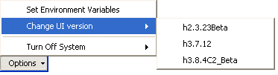
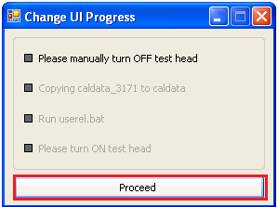
Change UI procedure
From the tool’s User Interface, click options select Change UI version, then click on the desired UI version
A window will appear, click proceed
The tool will ask you to manually turn off the test head. Change UI will not proceed unless this is done
After turning off the test head the tool will copy the caldata, then run userel.bat. Follow the instructions in userel
When userel is complete turn on the test head and close the “Change UI Progress” Window

Slide 6
End

